Slide 1

Listening for Differences and Telling More Powerful Stories
Noticing and leveraging different kinds of change: technical and cultural
Sharon Benjamin, Ph.D.,

Slide 2

On The Technical Side
Technical challenges are problems that melt in the face of evidence about how to improve outcomes.

Slide 3
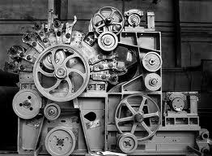

Toyota helped make the assembly of cars vastly more efficient and profitable.
Giving possible heart attack
victims aspirin improves
mortality.

Slide 4
Technical Problems
Are often permanently solved as research and evidence accumulate about the best ways to do things.
New technology often opens the door to solving stubborn problems.
Technical problems have solutions that can be universally applied.
Technical problems usually have COMPLICATED solutions: new processes, procedures.

Slide 5
But Not All Problems Are Technical
There is a category of problem that resists permanent solution – these are problems that we think we have fixed and then they pop back up.
These kind of problem usually relate to people, people’s behavior and local differences that result in barriers to adoption of technical solutions.
These problems lead to frustration, resignation and cynicism.

Slide 6
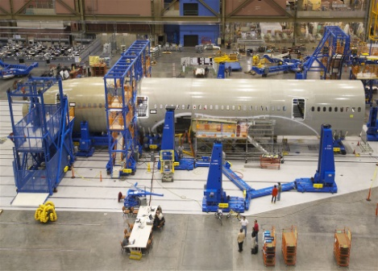

We Often Get Confused And Try Technical Solutions for Nontechnical Problems
≠
What works in technical situations often doesn’t work with challenges that relate to human behavior…………….We need solutions that ADAPT to human needs………….

Slide 7

Solutions That Adapt to Organizational Culture
Which flower is the RIGHT one?

Slide 8
How Do You Know Which Is Which?
If you present a new idea or solution and what you hear is:
“Yeah, but…………”
“That won’t work here because………….”
Or, you implement a new solution and get a fast start that fizzles………..it might be problem of behavior and culture – you’re in the adaptive zone!

Slide 9




Better Stories Can Change Culture

Slide 10
What’s Your Story?
Analysis of data is not sufficient…..even the Harvard Business Review agrees!
Being able to tell the story of your work is critically important to sustaining performance improvements
The age old art of storytelling is one of the most effective tools leaders can use……
Harvard Business Review

Slide 11
5 Elements of Every Good Story
It is about a person or group whose struggles we can relate to.
In the opening, the stakes are high & something has changed that compels the characters to act differently.
Obstacles produce drama, frustration & conflict.
A turning point. The characters can no longer do things as they have in the past.
A resolution. “They lived happily ever after…”

Slide 12
How Does This Apply to You?
Introduce the main characters – who’s involved? Try to pick a single main character to open the story – a nurse, a patient….
Set the stakes – why does this story matter?
What’s changed that requires a different course of action today than what’s happened in the past?
Tell the truth about obstacles, barriers, conflict, frustration – this is where we learn from you! It’s OK to be confused and messy at this stage.
Tell us the ending: we reduced UTIs and improved client’s quality of life.

Slide 13
But wait there’s more!
Great stories have catchy titles --
A good title is usually short, punchy and captures the mood and outcome of the story
A good title helps listeners REMEMBER the important meaning of the story

Slide 14

Listen! Something’s Changing….
Boosting the Power of Your Story

